Slide 1
HVPC
Dr. Gaurav C. Mhaske
Dept. Of Neurophysiotherapy
MGM Institute Of Physiotherapy
Chh. Sambhajinagar

Slide 2
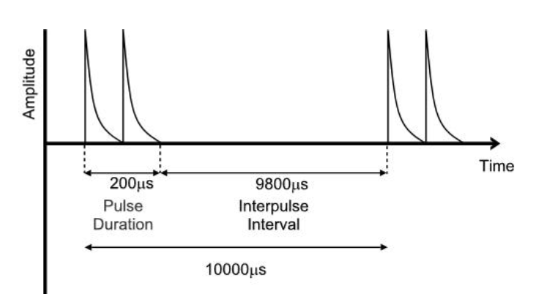

Slide 3
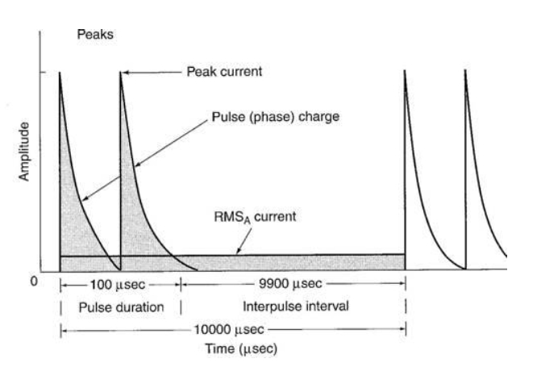

Slide 4
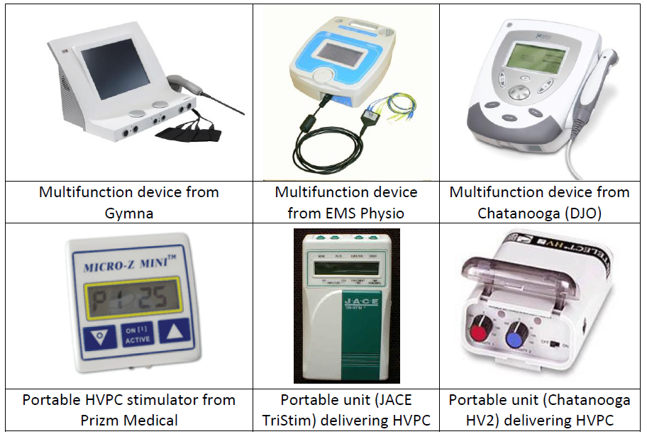

Slide 5
Physiological effects
Maintaining or increasing range of motion.
Re-educating muscles.
Edema/swelling/inflammation reduction.
Reducing motor spasticity.
Increasing local blood circulation to injured area and promoting fluid movement to and from treatment area.

Slide 6
Preventing or retarding muscle disuse atrophy.
Managing chronic/post-traumatic/post-surgical pain conditions allowing patient to participate in their pain management program.
Stimulation and acceleration of wound healing by promoting blood circulation to wound.

Slide 7
INDICATIONS
Adhesive Capsulitis ,Bursitis
Wound Healing,Odema
Cervical Sprain/Spasm
Degenerative Disc,Sciatica
Epicondylitis
Lumbosacral Sprain
Shoulder Subluxation, TMJ
Post Operative conditions-Arthroscopy, Discectomy, Spinal Fusion

Slide 8
Duration
Minimum of 30-40 mins /3xday
Application
The positive pad is like ice, tending to reduce circulation to the area under the pad and reduction in swelling. The negative pad is like heat, promoting increased circulation, reportedly speeding healing.

Slide 9
DIADYNAMIC CURRENT

Slide 10
Diadynamic is one of the most common devices of electro-therapy, which uses a low current for its analgesic and spasmolytic effect.
Diadynamic currents are mixed currents, which use effects of the concurrent application of galvanic and faraday, or other impulse-like currents.
This results in combined effects of both types of currents, especially induction of hyperaemia and analgesia.
The galvanic current component is combined with impulse component.

Slide 11
Sinusoid-like impulse currents have inhibitory or facilitation effect, which depends on the frequency, intensity and other parameters.
The current with predominantly inhibitory effect has the frequency 100 Hz, current with frequency 50 Hz acts rather dynamogenically, i.e. causing excitation, facilitation and supporting muscle tone, it eliminates oedema around the nerve envelope, reducing pain and supporting muscle tone.

Slide 12
Two main types which are characterized by the different types of waveforms produced by the device.
Half-wave rectification (single phase or monophasé fixe (MF))
Eliminates the second half of each AC cycle to produce a monophasic pulsed current with a pulse duration equal to the interpulse interval and a frequency equal to that of the original AC

Slide 13
Full-wave rectification (double phase or diphasé fixe (DF))
Produces a monophasic pulsed current with no interpulse internal at twice the original AC frequency

Slide 14
DIADYNAMIC CURRENT
Diadynamic currents are basically a variation of sinusoidal current. They are monophasic sinusoidal currents (rectified alternating current) with duration of 10 ms

Slide 15
Types of diadynamic current
It has five classic current types:
1- DF (diphase Fixe)
2- MF (monophase Fixe)
3-CP (Courtes Periodes),
4- LP (Longues Periodes)
5-RS( Syncopal Ryhthm)

Slide 16
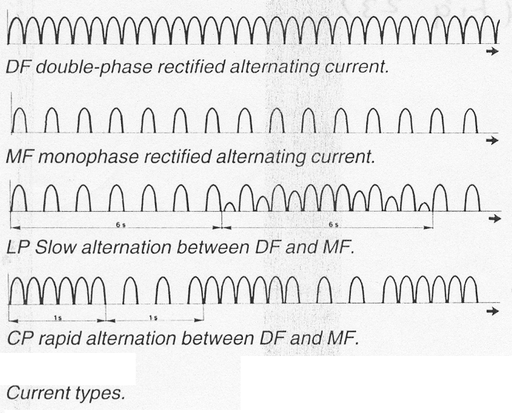
1- DF (diphase Fixe):
- Full wave rectified alternating current
Frequency 100 Hz
The patient feels tickling sensation and muscle contraction occurs only at high intensities
Used for initial treatment and has analgesic effect

Slide 17
2- MF (monophase Fixe)
- Half wave rectified alternating current
Frequency 50 Hz
The patient feels strong vibration sensation
It is used in treatment of pain without muscle spasm
MF current can cause muscle stimulation at lower intensity then with DF.

Slide 18
3-CP (Courtes Periodes, short periods)
Rapid alternation between one second of MF current and one second of DF without interval pauses.

Slide 19
4- LP (Longues Periodes, long periods)
Slow alternation between six seconds of MF current and six seconds DF phase in which a peak intensity is varied.
CP and LP are used to prevent accommodation.
CP and LP currents has analgesic effect and used in treatment of traumatic and neurogenic pain

Slide 20
5. RS (Syncopal Rhythm):
It comprises 1-sec phase of MF, followed by a 1-sec rest phase.

Slide 21
Physiological effect
1- Relief of pain due to
Direct mechanism
Stimulation of sensory nerves leading to pain relief through stimulation of pain gate mechanism
Indirect mechanism
Improving circulation through pumping action of muscle contraction with subsequent removal of irritant wastes
2- Increase local circulation due to
Release of H -like substance due to polar effect
Altering autonomic activity

Slide 22
3- Decrease inflammation and swelling
Due to increased local circulation and change of cell membrane permeability
4- Muscle re-education due to
stimulation of motor nerves but it is not the current of choice for muscle strengthening

Slide 23
Electrochemical effect of diadynamic current
Diadynamic current has relative high DC amplitude, so that there is a significant chance of skin damage occurrence.
Skin damage is due to electrochemical changes and changes in the pH value of the skin.
To keep the risk of skin damage to minimum, treatment time should be limited to ten minutes.

Slide 24
Indications
Soft tissue injury as sprains, contusions and epicondylitis
Treating pain especially in small joints.
Sudeck’s atrophy.
Peripheral nerve disorders as neuralgia, radiculopathy and herpes zoster.

Slide 25
Contraindications
Open skin as the current tend to concentrate
Bony areas
Loss of sensation
Infection
Unreliable patients
Superficial metals
Thrombosis.
Cardiac pace makers.

Slide 26
Dosage
Intensity: It should be increased gradually until definite vibration or prickling sensation occurs.
Duration: Not more than 12 minutes; each type for 3 minutes.
Frequency: Daily or every other day for 12 sessions.

Slide 27
DF: It is used for the initial treatment and before application of other currents. The patient feels a prickling sensation, which subsides after a short time.
MF: The patient feels a strong vibration for longer time than the sensation of DF. It is used for treatment of pain without muscle spasm.

Slide 28
CP: In DF phase, there are fine tremors in MF phase (strong and constant vibration). There are rhythmic contractions, being used for treatment of traumatic pain.
LP: It has a long-lasting analgesic effect. It is used with combination of CP in treatment of neuralgia.
RS: It can be used for faradic stimulation of the muscle and as a test for motor nerve excitability.

Slide 29
MICROCURRENT
A current delivered at very low intensity
The usual clinical stimulators have currents outputs as high as 80 – 100 mA.
The maximum output is normally less than 1mA.
Micro current range from monophasic or biphasic pulses with a frequency of up to 10Hz and a duty cycle up to 50%.

Slide 30
INDICATIONS
Adhesive Capsulitis ,Bursitis
Wound Healing,Odema
Cervical Sprain/Spasm
Degenerative Disc,Sciatica
Epicondylitis
Lumbosacral Sprain
Shoulder Subluxation,TMJ
PostOperative conditions-Arthroscopy,Discectomy,Spinal Fusion

